Slide 1

Toyota Executive Scrum Board
Team 2 – CS 499 – 001 – Fall 2017

Slide 2




Team Members
Logan Hickey
Communications/Scrum Manager
Thomas Wheeler
Project Manager
Jonah Starling
Front End Lead
Irsyad Hanif
Back End Lead

Slide 3

Problem Statement
Proposed System
Logan Hickey
Communications/
Scrum Manager

Slide 4
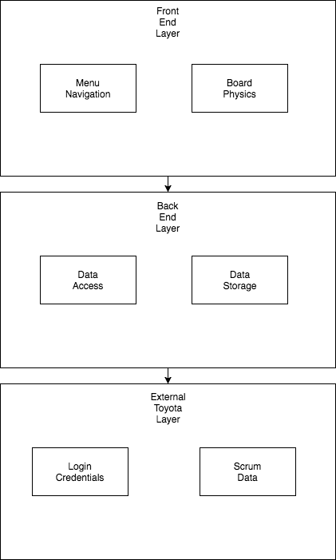
Architecture Model → Current Major Task
Irsyad Hanif
Back End Lead

Slide 5
Testing
Adaptive Testing
~Handling fast turnover of project scope.
Acceptance Testing
~Changing non-functional requirements to meet Toyota’s.
Unit Testing
~Increasing complexity.
~Back-end linking problems = stand still for unit testing.
Thomas Wheeler
Project Manager

Slide 6
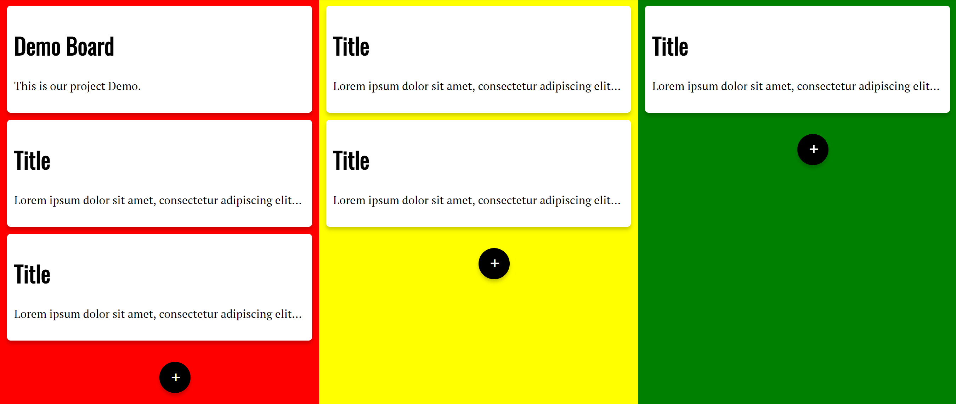
Demo
Jonah Starling
Front End Lead

Slide 7
Team Review
Lines of Code/Backlog
~We currently have ~700 lines of code and are entering sprint #3
Product Size
~40 active basic test cases
Product Effort
~37.5 man hours per person, all group work
Project Defects
~Backend linking.
~Card Disappearing Nuance.
Logan Hickey
Communications/
Scrum Manager

Slide 8

Questions?

